Slide 1
Volume weight and shipping weight
Cases 1 – 3
Recalculate the volume to weight = volume weight
Compare the volumetric weight with the actual weight
What will be the highest weight?
= Shipping weight
Case 4 – 7 What kind of volume should we count on?
m3
PPL
FLM
Explain how you have calculated

Slide 2
Example of Volume conversion to weight
Shipping weight
The weight for which the goods owner must pay shipping

Slide 3
Volume weight and shipping weight
Case 1
Ellos AB has a delivery with road transport to Gislaved 15 kroner bags 750kg 5m3
What will be the volumetric weight?
5 x 280 = 1400kg
What will be the shipping weight?
1400kg

Slide 4
Volume weight and shipping weight
Case 2
Abba AB has a domestic delivery as well
10 europallets Kalles Kaviar 9,500kg 20m3 from Kungshamn to Örebro
What will be the volumetric weight?
20m3 x 280kg = 5600kg
10ppl x 780 = 7800kg
0.4 flm x 10 = 4 flm = 7800kg
What will be the shipping weight?
9500kg

Slide 5
Volume weight and shipping weight
Case 3
Pipeline AB in Ulricehamn has a domestic delivery to Stockholm
12eurpll/6ppl 3500kg
What will be the volumetric weight?
6ppl x 780 = 4680kg
6 x 0.4= 2.4 sc
2.4 x 1950 = 4680kg
What will be the shipping weight?
4680kg

Slide 6
Volume weight and shipping weight
Case 4
Lantmännen in Malmö has another domestic delivery
Jönköping.
8 eurpll 4500kg, the pallets can be double set
What is the volume of the goods? m3? PPL? FLM?
4 PPL
0.4 x 4 = 1.6 sc
What will be the volumetric weight?
1.6 x 1950kg = 3120kg
780 x 4 = 3120kg
What will be the shipping weight?
4500kg
Notes:
Volume weight
You can transfer from ppl to flm but not backwards

Slide 7
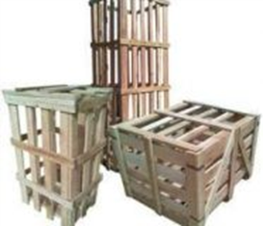
Volume weight and shipping weight
Case 5
Tekniska Maskineriet AB in Karlstad has a delivery to Kalmar.
3 hp 1250kg with machinery. Hck has the dimensions 1.5l x 0.8w x 1.80h. It is not possible to load anything above on hck
What is the volume of the goods? m3? PPL? FLM?
Flm
What will be the volumetric weight?
1.5 x 0.8 /2.4 (width of the flap) = 0.5 flm per piece
0.5 x 3 = 1.5 sc
(1.5m x 0.8m x 1.8m = 2.16 x 3 = 6.48 x 280 = 1814kg)
1.5 x 1950kg = 2925kg
What will be the shipping weight?
2925kg
Notes:
Krt = krats
Dimension changes

Slide 8
Volume weight and shipping weight
Case 6
Ecophone in Hyllinge has 8 eurpll 2600kg, they are 2m high, they are going to Sundsvall.
What volume should we count on? m3? PPL? FLM?
Flm or Ppl
What will be the volumetric weight?
3.2 Flm x 1950 = 6240kg
780 x 8 = 6240kg
What will be the shipping weight?
6240kg
Notes:
pll is always standard pallet place position, but differs in quality
M3 is always can stacked

Slide 9
Volume weight and shipping weight
Case 7
SSAB has 13 pll 12478kg from Oxelösund to Boliden.
What is the weight/volume of the delivery?
0.4 x 13 = 5.2 flm 10 140kg volumetric weight
Or 13 ppl x 780 = 10,140 volume weight
The shipping weight
12,478 kg

